Slide 1
Ethernet MAC

Slide 2
Introduction for CYT4BF
Hint Bar
Review TRM chapter 31 for additional details
Ethernet MAC is in the Peripheral blocks:

Slide 3
Ethernet MAC
Hint Bar
Review TRM chapter 31.1 for additional details
Media Access Control (MAC)
Physical layer (PHY)
Media Independent Interface (MII)
Reduced Media Independent Interface (RMII)
Gigabit Media Independent Interface (GMII)
Reduced Gigabit Media Independent Interface (RGMII)
Management Data Input/Output (MDIO)
Overview
Ethernet MAC module transmits and receives IEEE802.3 frames
MII or RMII¹ or GMII or RGMII² and MDIO
¹ RMII is the standard for reducing the number of signals needed to connect the PHY to the MAC than MII.
² RGMII is the standard for reducing the number of signals needed to connect the PHY to the MAC than GMII.

Slide 4
Ethernet MAC Overview
Hint Bar
Review TRM chapter 31.1 for additional details
Supports only OPEN Alliance specified RGMII standard
Features:
MII, RMII, GMII and RGMII PHY interface
MDIO interface for PHY management
10/100/1000 Mbit/s Ethernet MAC compatible with the IEEE 802.3
Full-duplex communication
Jumbo frame¹ (Max.1536 bytes)
IEEE 802.1Q: Virtual LAN (VLAN)
IEEE 802.3: Pause frame
IEEE 802.1BA: Audio Video Bridging Systems
IEEE 802.1Qav: Forwarding and Queuing Enhancements for Time-Sensitive Streams
IEEE 802.1AS: Timing and Synchronization for Time-Sensitive Application in Bridged LAN’s
IEEE 1588 – Precision Time Protocol
¹ Jumbo frame is not standardized by IEEE.

Slide 5
Ethernet Frame
Hint Bar
Review Register TRM for additional details
Start of Frame Delimiter (SFD)
Frame Check Sequence (FCS)
Frame format:
Basic Frame
7
-
octet
1
-
octet
6
-
octet
6
-
octet
2
-
octet
46
to
1500
-
octet
4
-
octet
S
DESTINATION
SOURCE
LENG
Payload
Preamble
F
TH
FCS
ADDRESS
ADDRESS
/
D
YPE

Slide 6
Ethernet MAC Block Diagram
Hint Bar
Review TRM chapter 31.2 for additional details
Refer to the Features List in the datasheet for additional details
Ethernet MAC components:
MAC Controller
PHY Interface
MAC Transmitter/Receiver
Time Stamp Unit
TX/RX Packet Mem
CLK Control
A
XI master interface
A
HB slave interface
E
thernet MAC
AXI
Interface
AHB
2
APB
AHB
Interface
TX
Packet Buff
MAC Control
(
MMIO
8
K
B
)
Time Stamp Unit
Registers
(
TSU
)
RX
Packet Buff
(
4
K
B
)
MAC Transmitter
MAC Receiver
CLK
_
GR
4
CLK
MII
Clock
_
MEM
/
RMII
/
GMII
/
RGMII
PHY Interface
Control
CLK
_
HF
and MDIO
5
CLK
_
HF
4

Slide 7
Ethernet MAC Block Diagram
Hint Bar
Review TRM chapter 31.3.14 for additional details
Ethernet MAC components:
PHY Interface:
Supports MII/RMII/GMII/RGMII PHY interface
Supports MDIO interface
A
XI master interface
A
HB slave interface
E
thernet MAC
AXI
Interface
AHB
2
APB
AHB
Interface
TX
Packet Buff
MAC Control
(
MMIO
8
K
B
)
Time Stamp Unit
Registers
(
TSU
)
RX
Packet Buff
(
4
K
B
)
MAC Transmitter
MAC Receiver
CLK
_
GR
4
CLK
MII
Clock
_
MEM
/
RMII
/
GMII
/
RGMII
PHY Interface
Control
CLK
and MDIO
_
HF5
CLK
_
HF
4

Slide 8
PHY Interface
Hint Bar
Review TRM chapter 31.3.14 for additional details
Supports following interface type and transfer rate:
Interface Type | Transfer Rate
 | 10 Mbit/s | 100 Mbit/s | 1000 Mbit/s
MII | ✓ | ✓ | -
RMII | ✓ | ✓ | -
GMII | - | - | ✓
RGMII | ✓ | ✓ | ✓

Slide 9
MII/RMII/GMII/RGMII Interface
Hint Bar
Review TRM chapter 31.3.14 and for additional details
Refer to the Package Pin List and Alternate Functions in the datasheet for additional details
Supported Signals:
Transmitter/Receiver signals:
Pin Name | Function of signals | MII | RMII | GMII | RGMII
TXD[1:0] | Transmit data [1:0] | ✓ | ✓ | ✓ | ✓
TXD[3:2] | Transmit data [3:2] | ✓ | - | ✓ | ✓
TXD[7:4] | Transmit data [7:4] | - | - | ✓ | -
TX_CTL | Transmit enable | ✓ | ✓ | ✓ | ✓
TX_ER | Transmit error | ✓ | - | ✓ | -
TX_CLK | Transmit clock | ✓ | - | - | -
RXD[1:0] | Receive data [1:0] | ✓ | ✓ | ✓ | ✓
RXD[3:2] | Receive data [3:2] | ✓ | - | ✓ | ✓
RXD[5:4] | Receive data [7:4] | - | - | ✓ | -
RX_CTL | Receive data valid | ✓ | ✓ | ✓ | ✓
RX_ER | Receive error | ✓ | ✓ | ✓ | -
RX_CLK | Receive clock | ✓ | - | ✓ | ✓
REF_CLK | Operation clock out | - | ✓ | ✓ | ✓
 | Operation clock in | - | ✓ | ✓ | ✓

Slide 10
Use case
Hint Bar
Review TRM chapter 31.3.14 for additional details
Register info - ETH_CTRL (REFCLK_SRC_SEL)
MII/RMII Interface:
Tx and Rx clock source can be supplied from either internal reference clock or from external clock source.
ETH_CTRL register must be used to select the reference clock source from internal reference clock or from HSIO

Slide 11
Use case
Hint Bar
Review TRM chapter 31.3.14 for additional details
Register info - ETH_CTRL (REFCLK_SRC_SEL)
GMII/RGMII Interface:
Tx clock source can be selected either from internal clock source or from HSIO
ETH_CTRL register must be used to selects reference clock source from internal reference clock or from HSIO
Tx clock source can be selected either from internal clock source or from HSIO
ETH_CTRL register must be used to selects reference clock source from internal reference clock or from HSIO

Slide 12
MDIO interface
Hint Bar
Review TRM chapter 31.3.12 for additional details
Supported Signals:
MDIO is a single bi-directional tristate signal between the Ethernet MAC and PHY
MDC is a clock for MDIO
MDC is generated by dividing CLK_GR4. MDC should not toggle faster than 2.5 MHz (minimum period of 400 ns), as defined by the IEEE 802.3az.
Use case
ETH_phy_management register is implemented as a shift register. Writing to this register starts a shift operation and outputs to MDIO pin.
Pin Name | Direction | Function of signals
MDIO | IO | Management Data Input/Output
MDC | O | Management Data Clock

Slide 13
Ethernet MAC Block Diagram
Hint Bar
Review TRM chapter 31.3.15 for additional details
Ethernet MAC components:
Clock supplied to EMAC
For internal operation
CLK_GR4
CLK_HF4
CLK_MEM
CLK_HF5
A
XI master interface
A
HB slave interface
E
thernet MAC
AXI
Interface
AHB
2
APB
AHB
Interface
TX
Packet Buff
MAC Control
(
MMIO
8
K
B
)
Time Stamp Unit
Registers
(
TSU
)
RX
Packet Buff
(
4
K
B
)
MAC Transmitter
MAC Receiver
CLK
_
GR
4
CLK
MII
Clock
_
MEM
/
RMII
/
GMII
/
RGMII
PHY Interface
Control
CLK
_
HF4
and MDIO
CLK
_
HF
5

Slide 14
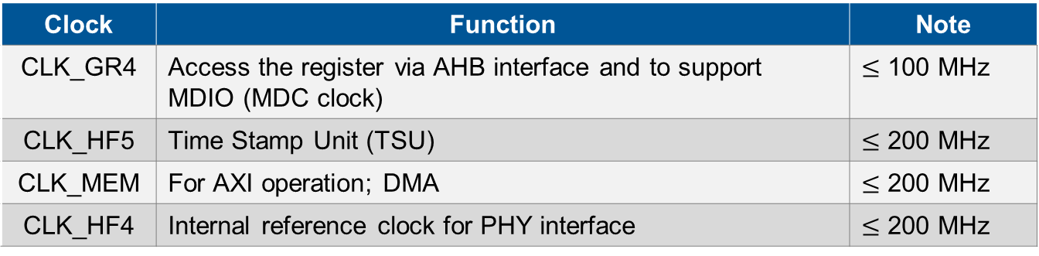
Clocks to EMAC
Hint Bar
Review TRM chapter 31.3.15 for additional details
The following clocks are used in Ethernet MAC block functions:
For internal operation
Clock | Function | Note
CLK_GR4 | Access the register via AHB interface and to support MDIO (MDC clock) | $≤$ 100 MHz
CLK_HF5 | Time Stamp Unit (TSU) | $≤$ 200 MHz
CLK_MEM | For AXI operation; DMA | $≤$ 200 MHz
CLK_HF4 | Internal reference clock for PHY interface | $≤$ 200 MHz

Slide 15
Power Modes
Hint Bar
Ethernet MAC availability in different power modes
Power Modes | IP Status
Active | Fully operational
LPActive | Fully operational; clocks can be limited to save some power
Sleep | Fully operational
LPSleep | Fully operational; clocks can be limited to save some power
DeepSleep | No clock provided during this mode, hence the logic is not functional. All retention registers will hold the values
Hibernate | Entire EMAC including retention register are not functional

Slide 16
Ethernet MAC Block Diagram
Hint Bar
Review TRM chapter 31.3.2 and 31.3.3 for additional details
Ethernet MAC components:
EMAC DMA
MAC Transmitter
MAC Receiver
Time Stamp Unit (TSU)
A
XI master interface
A
HB slave interface
E
thernet MAC
AXI
Interface
AHB
2
APB
AHB
Interface
TX
Packet Buff
MAC Control
(
MMIO
8
K
B
)
Time Stamp Unit
Registers
(
TSU
)
RX
Packet Buff
(
4
K
B
)
MAC Transmitter
MAC Receiver
CLK
_
GR
4
CLK
MII
Clock
_
MEM
/
RMII
/
GMII
/
RGMII
PHY Interface
Control
CLK
and MDIO
_
HF5
CLK
_
HF
4

Slide 17
EMAC DMA
Hint Bar
Review TRM chapter 31.3.1 for additional details
Performs below types of operation
Receive Buffer Descriptors read/write
Transmit Buffer Descriptors read/write
Received data DMA write
Transmit data DMA read
Responsible to transfer data between SRAM and EMAC using Packet buffer mode
8 KB internal transmit packet buffer
4 KB internal receive packet buffer
Data Transfer Modes
Partial Store and Forward Mode
Full Store and Forward Mode

Slide 18
Internal Data Path for DMA Packet buffer mode
Hint Bar
Review TRM chapter 31.3.2 and 31.3.3 for additional details

Slide 19
Tx and Rx Buffer Descriptors
Hint Bar
Review TRM chapter 31.3.1.5 and 31.3.1.6 for additional details
Configuration parameters for transmit and receive get stored in Buffer Descriptors
Resides in SRAM
Memory must be configured as non-cacheable
Base address for the BDs must be 32 bits aligned
Depending on Descriptor Time Capture mode, BDs are of
64 bits when disabled
128 bits when enabled
Base address for BD list is pointed by respective queue pointer registers. Such as receive_q_ptr, receive_q1_ptr, transmit_q_ptr
Allows Ethernet packets to be scattered in the memory

Slide 20
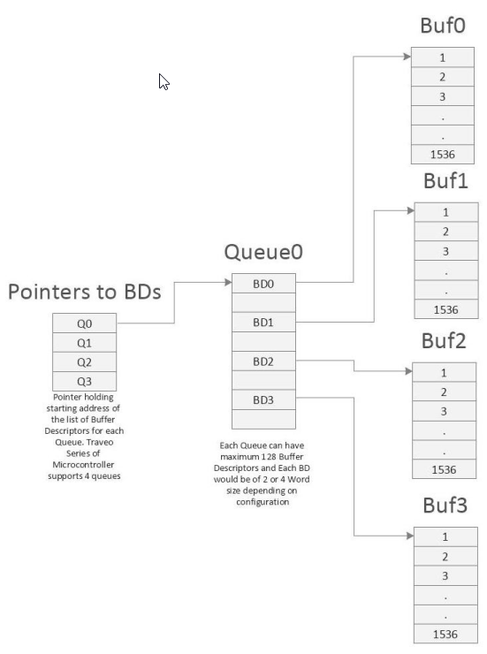
Tx and Rx Buffer Descriptors
Hint Bar
Review TRM chapter 31.3.1.5 and 31.3.1.6 for additional details
Buffer Descriptors (BD)
64/128 bits Transmit BDs
Buffer Address
Length
Checksum offload, CRC, Last buffer
Used and Last BD
Status bits
Time stamp and Errors
64/128 bits Receive BDs
Buffer Address
Ownership and First/Last BD
Filter match
Status bits
SOF and EOF and Length
Time stamp

Slide 21
EMAC DMA
Hint Bar
Review TRM chapter 31.3.1 for additional details
Tx and Rx BDs fetched in advance to enhance the performance
Upon enabling transmit, buffers are fetched from the highest priority queue’s buffer descriptors, followed by second highest priority queue …. least priority queue
Tx Packet buffer signals MAC transmitter block to fetch the data depending on the data transfer mode
Tx Packet buffer continues fetching data until the packet buffer memory is full or maximum limit of 256 packets have reached

Slide 22
DMA Data Transfer Modes
Hint Bar
Review TRM chapter 31.3.1 for additional details
Partial Store and Forward Mode
MAC transmitter starts fetching data from packet buffer when number of available bytes are more than configured watermark level.
Does not have to wait until entire frame is fetched from external SRAM
Increases overall system throughput due to less latency time
Disadvantages:
Does not allow multi buffer frame
TCP/UDP checksum offload cannot be used

Slide 23
DMA Data Transfer Modes
Hint Bar
Review TRM chapter 31.3.1 for additional details
Full Store and Forward Mode
Tx Packet buffer waits until entire frame is loaded into the buffer before signaling MAC transmitter block
Packet buffer holds entire frame until frame is successfully transmitted and status bits are written back to BDs
During receive process frame only gets forwarded to SRAM when entire frame gets validated
Triggers overrun error condition when Rx packet buffer is full and no buffer available to store received frame
Benefits
No need to fetch entire frame in case transmit error occurs, hence saves AXI transactions
Doesn’t transfer frame in case of faulty frame received
Allows multibuffer frames
Allows usage of IP/TCP/UDP checksum offload feature

Slide 24
EMAC Transmitter
Hint Bar
Review TRM chapter 31.3.1 for additional details
Fetches data from packet buffer once packet buffer has enough data
Start assembling frame by attaching
Preamble
Start Frame Delimiter (SFD)
Payload
If necessary, adds dummy data to make frame at least of size 60 bytes
Calculated CRC
Interframe Gap
Transmits frame using MII/RMII/GMII/RGMII
Updates the statistics register depending on the condition; success/failure/error counters

Slide 25
EMAC Receiver
Hint Bar
Review TRM chapter 31.3.1 for additional details
Receives frame and validates
Correct preamble
FCS
Frame length and data alignment
Based on activated Filter types, received frames either gets written to DMA or not; Filters available such as
Specific source or destination addresses
Type ID/Ether Type
Broadcast enabled/disabled
Pause frames
VLAN support enabled/disabled
Hash addressing
Copy all frames
Received frame gets forwarded to receive packet buffer and relevant statistics register gets updated

Slide 26
EMAC Receiver
Hint Bar
Review TRM chapter 31.3.1 for additional details
Depending on the configured Screener registers, received frame gets written to configured buffer pointed to by Rx BD
EMAC supports 16 Screening Type 1 and 16 Screening type 2 registers
Screener Type 1 registers allocates frame based on
Differentiated services (DS) field of IPv4
Traffic class (TC) of IPv6
UDP destination port
Screener Type 2 registers screens frames based on
Ether Type
VLAN Priority
Field compare register A, B, C
Unmatched frame gets routed to priority queue 0

Slide 27
Transmit Flow
Procedure:
IP Datagrams located in SRAM are transferred to TX Packet Memory using EMAC DMA
1
1
A
XI master interface
A
HB slave interface
E
thernet MAC
AXI
Interface
AHB
2
APB
AHB
Interface
TX
Packet Buff
MAC Control
MMIO
(
8
K
B
)
Time Stamp Unit
Registers
(
TSU
RX
Packet Buff
)
(
4
K
B
)
MAC Transmitter
MAC Receiver
CLK
_
GR
4
MII
Clock
CLK
_
MEM
/
RMII
/
GMII
/
RGMII
PHY Interface
Control
CLK
_
HF
and MDIO
5
CLK
_
HF
4

Slide 28
Transmit Flow
Procedure:
IP Datagrams located in SRAM are transferred to TX Packet Memory using EMAC DMA
IP Datagram is transferred to MAC Transmitter block
1
2
1
A
XI master interface
A
HB slave interface
E
thernet MAC
AXI
Interface
AHB
2
APB
AHB
Interface
TX
Packet Buff
MAC Control
MMIO
(
8
K
B
)
2
Time Stamp Unit
Registers
(
TSU
RX
Packet Buff
)
(
4
K
B
)
MAC Transmitter
MAC Receiver
CLK
_
GR
4
MII
Clock
CLK
_
MEM
/
RMII
/
GMII
/
RGMII
PHY Interface
Control
CLK
_
HF5
and MDIO
CLK
_
HF
4

Slide 29
Transmit Flow
Procedure:
IP Datagrams located in SRAM are transferred to TX Packet Memory using EMAC DMA
IP Datagram is transferred to MAC transmitter block
Entire MAC frame is constructed by appending preamble, CRC, interframe gap and transmitted by the MAC transmitter block
1
2
3
1
A
XI master interface
A
HB slave interface
E
thernet MAC
AXI
Interface
AHB
2
APB
AHB
Interface
TX
Packet Buff
MAC Control
MMIO
(
8
K
B
)
2
Time Stamp Unit
Registers
(
TSU
RX
Packet Buff
)
(
4
K
B
)
MAC Transmitter
3
MAC Receiver
CLK
_
GR
4
MII
Clock
CLK
_
MEM
/
RMII
/
GMII
/
RGMII
PHY Interface
Control
CLK
_
HF5
and MDIO
5
CLK
_
HF
4

Slide 30
Receiver Flow
Procedure:
Incoming MAC frame is verified and filtered by the hardware
1
A
XI master interface
A
HB slave interface
E
thernet MAC
AXI
Interface
AHB
2
APB
AHB
Interface
TX
Packet Buff
MAC Control
MMIO
(
8
K
B
)
Time Stamp Unit
Registers
(
TSU
RX
Packet Buff
)
(
4
K
B
)
MAC Transmitter
1
MAC Receiver
CLK
_
GR
4
MII
Clock
CLK
_
MEM
/
RMII
/
GMII
/
RGMII
PHY Interface
Control
CLK
_
HF5
and MDIO
CLK
_
HF
4

Slide 31
Receiver Flow
MAC Receiver:
Incoming MAC frame is verified and filtered by the hardware
Depending on configuration, frame would be forwarded to Rx Packet buffer memory
1
2
A
XI master interface
A
HB slave interface
E
thernet MAC
AXI
Interface
AHB
2
APB
AHB
Interface
TX
Packet Buff
MAC Control
MMIO
(
8
K
B
)
Time Stamp Unit
Registers
(
TSU
RX
Packet Buff
)
(
4
K
B
)
MAC Transmitter
1
2
MAC Receiver
CLK
_
GR
4
MII
Clock
CLK
_
MEM
/
RMII
/
GMII
/
RGMII
PHY Interface
Control
CLK
_
HF5
and MDIO
CLK
_
HF
4
¹ Support to DMA transfer. DMAC is implemented in the MAC Control.

Slide 32
Receiver Flow
MAC Receiver:
Incoming MAC frame is verified and filtered by the hardware
Depending on configuration, frame would be forwarded to Rx Packet buffer memory
Depending on the filters and configured screening registers, received frame would be written at receive buffer pointed by next available Rx BD
1
2
3
3
A
XI master interface
A
HB slave interface
E
thernet MAC
AXI
Interface
AHB
2
APB
AHB
Interface
TX
Packet Buff
MAC Control
MMIO
(
8
K
B
)
Time Stamp Unit
Registers
(
TSU
RX
Packet Buff
)
(
4
K
B
)
MAC Transmitter
1
2
MAC Receiver
CLK
_
GR
4
MII
Clock
CLK
_
MEM
/
RMII
/
GMII
/
RGMII
PHY Interface
Control
CLK
_
HF
and MDIO
5
CLK
_
HF
4

Slide 33
Pause Frame Support
Hint Bar
Review Register TRM for additional details
Priority Flow Control (PFC)
Enhanced Transmission Selection (ETS)
Register info - ETH_network_config - ETH_pause_time
Pause frame is used to prevent the own self buffer overflow
Fix value
Set to the following register.
- ETH_pause_time
If enabled, Pause frame can be used to stop transmission for defined time period
Time is defined in terms of Quanta; 1 Quanta = 512 bits time period

Slide 34
Pause frame Support
Hint Bar
Review Register TRM for additional details
Priority Flow Control (PFC)
Enhanced Transmission Selection (ETS)
Register info - ETH_network_config - ETH_pause_time
Pause frames to can be transmitted with zero quanta (to resume transmission) or with non-zero quanta time period
If receiving Pause frames enabled, EMAC stops transmission right after receiving non-zero quanta Pause frame
Classical IEEE 802.3 Pause frame:
Destination address of 0180C2000001h
A source address taken from Specific Address 1 register
Type ID of 8808h
Pause opcode of 0001h
Pause quantum register
Padding of 00h to take the frame to minimum frame length
Valid FCS

Slide 36
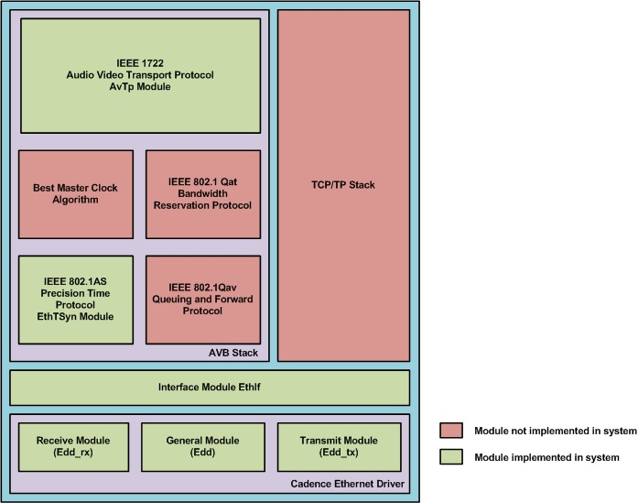
Software Modules

Slide 37
IP/TCP/UDP Checksum Offloading
Hint Bar
Review TRM chapter 31.3.5 for additional
IPv4, TCP and UDP frames have 16 bits checksum included for the payload
EMAC is capable to generate and verify the checksum for these frame types
If checksum fails to verify while receiving, frame is discarded, and error counter gets incremented
For transmit checksum generation occurs only if the frame format is recognized by the MAC, otherwise frame will be sent without checksum and respective status bits get updated.

Slide 38
MAC frame
Hint Bar
Review Register TRM for additional details
Start of Frame Delimiter (SFD)
Flag check sequence (FCS)
Frame format:
Basic Frame
Q-tagged frame

Slide 39
Jumbo Frame Support
Hint Bar
Review Register TRM for additional details
Register Info - ETH_jumbo_max_ length
The maximum length of Traveo II jumbo frame payload is 1536 bytes
MAC CLIENT LENGTH/TYPE
Set to the following register.
- ETH_jumbo_max_length register

Slide 40
VLAN Support
Hint Bar
Review Register TRM for additional details
Tag Protocol Identifier (TPID)
Tag Control Information (TCI)
Priority Code Point (PCP)
Canonical Format Indicator (CFI)
VLAN identifier (VID)
Register info - ETH_network_config - ETH_stacked_vlan - ETH_dma_config - ETH_screening_type_2 _register_0 to 15
Provides a virtual LAN group in the network by VLAN tag
VLAN tag is inserted into the Q-tagged frame
VLAN Tag
Set to the following register.
- ETH_stacked_vlan
Set to the following register.
- ETH_screening_type_2 _register_0 to 15
Set to the Buffer descriptor.

Slide 41
Audio Video Bridging Systems Support
Hint Bar
Review Register TRM for additional details
Time Stamp Unit (TSU)
Forwarding and Queuing Enhancements for Time-Sensitive Streams (FQTSS)
Supports the timing and synchronization (IEEE 802.1AS)
Supports the TSU
Ethernet MAC has a TSU compatible to IEEE 1588
Supports the FQTSS (IEEE 802.1Qav)
Ethernet MAC has registers to support FQTSS
FQTSS is controlled by software using registers and supports priority control of transmission data

Slide 42
Revision History
Revision | ECN | Orig. of Change | Submission Date | Description of Change
** | XXXXXX | SHUS | XX/XX/2018 | Initial release

